Slide 1

BITCOIN PRICE
FORECASTING
GROUP MEMBERS:
SOHAM SHAH (002837154)
ABHISHEK MATHUKIYA (002839155)
Notes:
A- So we are Team18, myself Soham Shah and my friend Abhishek Mathukiya, So today, We are going to present on Bitcoin Price Forecasting project so coming to introduction

Slide 2
INTRODUCTION
The Bitcoin Price Dataset opens up numerous avenues for exploration and analysis, driven by the availability of high-frequency data.
Bitcoin offers the promise of lower transaction fees than traditional online payment mechanisms and, unlike government-issued currencies, it is operated by a decentralized authority.
This project will develop predictive models using historical prices, opening, and closing economic factors (like oil prices and holidays) to improve forecasting accuracy.
The ultimate-goal is to create an accurate and reliable predictive model that can effectively forecast Bitcoin's price movements.
Notes:
A- we're diving into the world of Bitcoin and its price movements. Our project focuses on forecasting Bitcoin prices using a combination of historical data and economic factors from From 2017-2023"
- "Why is this important? Well, with Bitcoin's wild swings, knowing what might happen next can really give traders and investors an edge. That's exactly what we've tried to capture with our models."
Understanding Bitcoin's price movements helps investors make informed decisions, providing insights into market trends and potential future prices

Slide 3
The dataset has total of 1 csv file and 10 columns
The Dataset has around 3M+ records and the size is approximately 333.38MB.
DATASET
Notes:
A- The dataset is substantial, at over 333.38MB, suggesting a significant amount of information to analyze.
Record Count: With over 3 million records, it offers a rich source of data for exploration and analysis.
Column Information: The dataset contains 10 columns, indicating multiple variables or attributes to investigate.

Slide 4
STEP 1
Data Preprocessing
STEP 2
Exploratory Data Analysis
STEP 3
METHODOLOGY
Feature Engineering
STEP 4
Model Selection & Evaluation
STEP 5
Prediction
Notes:
A- Data Preprocessing:
"We started by cleaning up our data, making sure everything's neat and ready for analysis."
Feature Engineering:
"Next, we picked out the important bits that help us predict Bitcoin prices better."
Exploratory Data Analysis (EDA):
"Then, we dived into the data, making graphs to see what's been going on with Bitcoin."
Model Selection & Evaluation:
"After that, we tried out different prediction methods to see which one was the sharpest model in the shed."
Prediction:
"And finally, we used our best tool to forecast where Bitcoin might be heading next."

Slide 5

SO, WE STARTED BY IMPORTING AND ORGANIZING THE BITCOIN PRICE DATASET FROM KAGGLE
DATA PREPROCESSING
THIS STEP ALSO INVOLVED CLEANING DATA, HANDLING MISSING VALUES, AND FORMATTING THE DATA FOR ANALYSIS
CHECKED FOR ALL THE NULL AND DUPLICATE ROWS
Notes:
A- -"In the Data Preprocessing phase, our main objective was to ensure the quality and integrity of the data before any analysis or modeling took place.
Data Importation:
We began by importing the dataset from Kaggle
Organization:
meant verifying the data schema and ensuring that each variable was correctly categorized.
Cleaning:
The cleaning process involved multiple steps:
Handling Missing Values:
Removing Duplicates: Formatting:

Slide 6
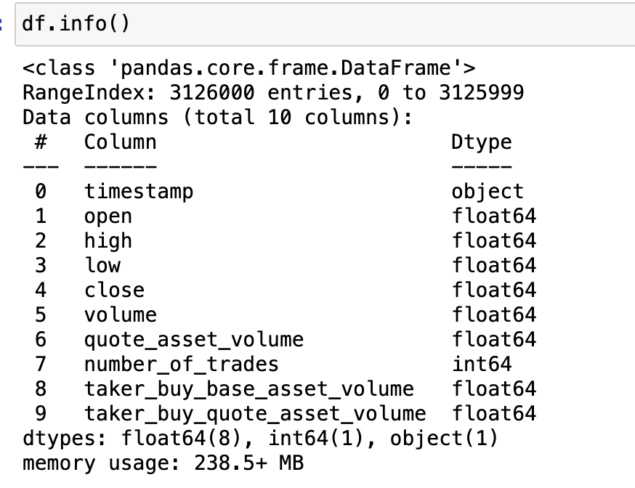
DATA INFORMATION
So, for our dataset the datatypes (dtype) is seen in the above code snippet
Notes:
S- Timestamp: Marks the exact date and time each Bitcoin data was recorded.
Open: The price of Bitcoin at the beginning of the trading interval.
High: The highest price Bitcoin reached during the trading interval.
Low: The lowest price Bitcoin dropped to during the trading interval.
Close: The price of Bitcoin at the end of the trading interval.
Volume: How much Bitcoin was traded during the interval.
Quote Asset Volume: The total value of trades in regular currency during the interval.
Number of Trades: The count of individual Bitcoin trades that happened in the interval.
Taker Buy Base Asset Volume: How much Bitcoin was bought by active buyers in the interval.
Taker Buy Quote Asset Volume: The value of what active buyers spent in regular currency on Bitcoin during the interval.

Slide 7
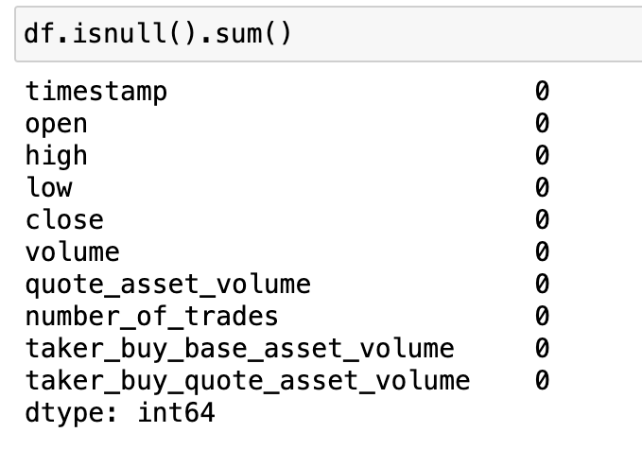
CHECKING FOR NULL VALUES
In any Dataset a particular attention is given to handling missing data, as missing values can significantly distort the outcome of data analysis if not addressed appropriately. So, checking for NULL or missing or duplicate values is always essential.
The code snippet above showcases there are no NULL values in our dataset
Notes:
S- This slide indicates that a thorough check was performed on the Bitcoin dataset to ensure there are no gaps or missing pieces of information, which is essential for accurate data analysis. The provided code snippet has been executed to sum up any null values across all columns, and the result shows zeroes across the board. This confirms that our dataset is complete with no missing values, allowing for a more reliable and robust analysis.

Slide 8
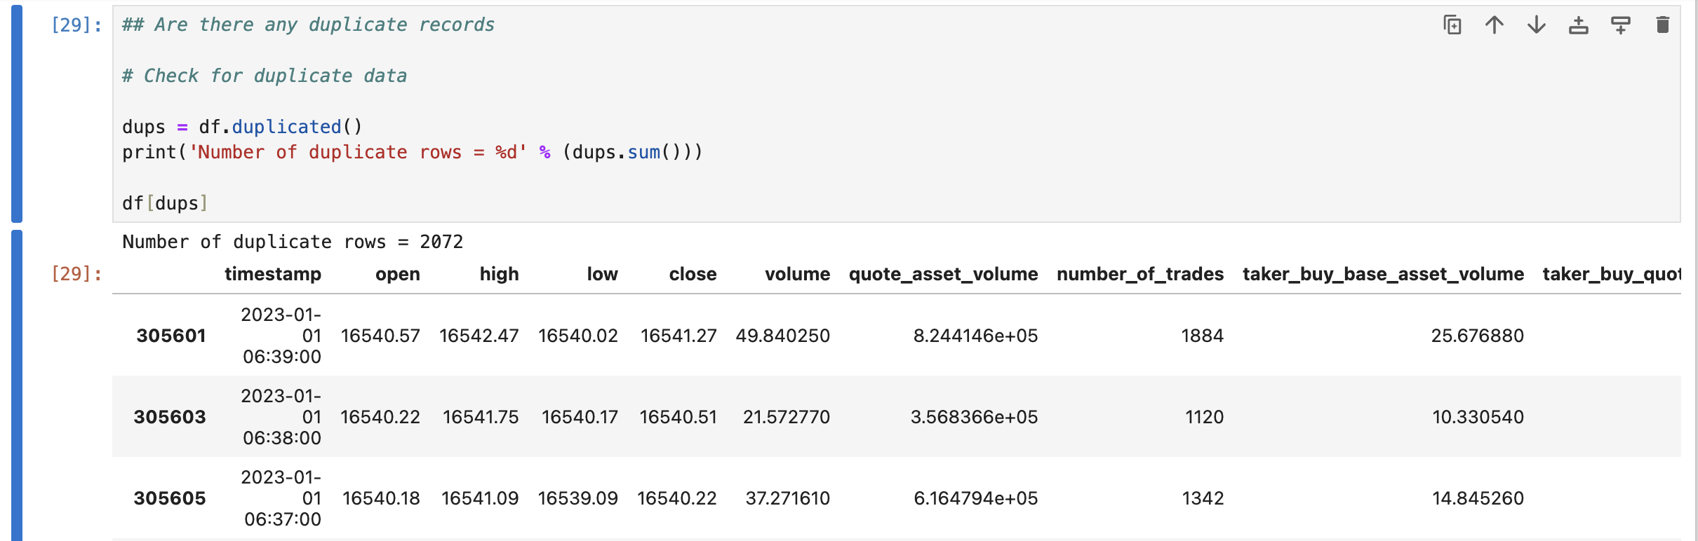
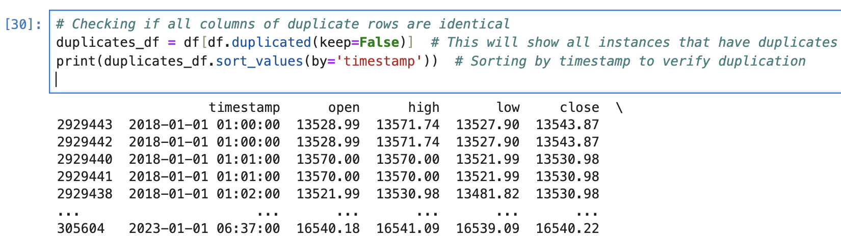
DUPLICATE ROWS
So, there were around 2072 duplicated rows
Also, checked if there are identical duplicate rows and found out that there are 4144 rows
Notes:
S- This slide is about ensuring the uniqueness of the data by identifying and addressing duplicate rows. It shows that initially, 2072 duplicate rows were detected in the dataset. Further inspection revealed that there are exactly 4144 rows that are completely identical across all columns. This step is crucial for maintaining data quality, as duplicates can distort the analysis and lead to inaccurate models. The code snippets and table view provide a transparent audit trail of the data cleaning process.

Slide 9
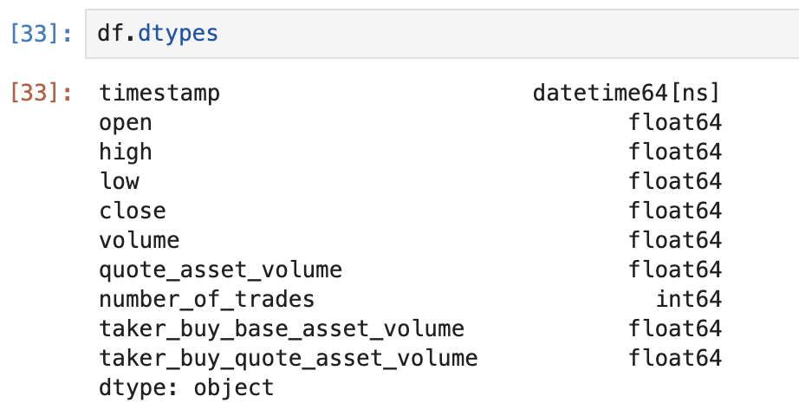
DATATYPE CHANGE
Changed the datatype for the timestamp column to datetime using this expression:
df['timestamp'] = pd.to_datetime(df['timestamp'])
Notes:
S- The code `df['timestamp'] = pd.to_datetime(df['timestamp'])` is a command in Pandas that transforms the 'timestamp' column from its current format into a datetime format, which is more appropriate for any operations that require date and time functionality.
Since this is timecast forecasting, that's why we changed the datatype of timestamp to datetime

Slide 10
EXPLORATORY DATA ANALYSIS
Notes:
S- So, coming up next is EDA, which is the important step for analyzing behaviors, underlying patterns and distributions within the dataset and that Is achieved by plotting graphs or charts
The exploratory data analysis (EDA) phase was carried out to uncover insights and understand the underlying patterns and distributions within the dataset.
This analysis was imp for analyzing behaviors in the data and identifying key variables that could influence our predictive models.

Slide 11
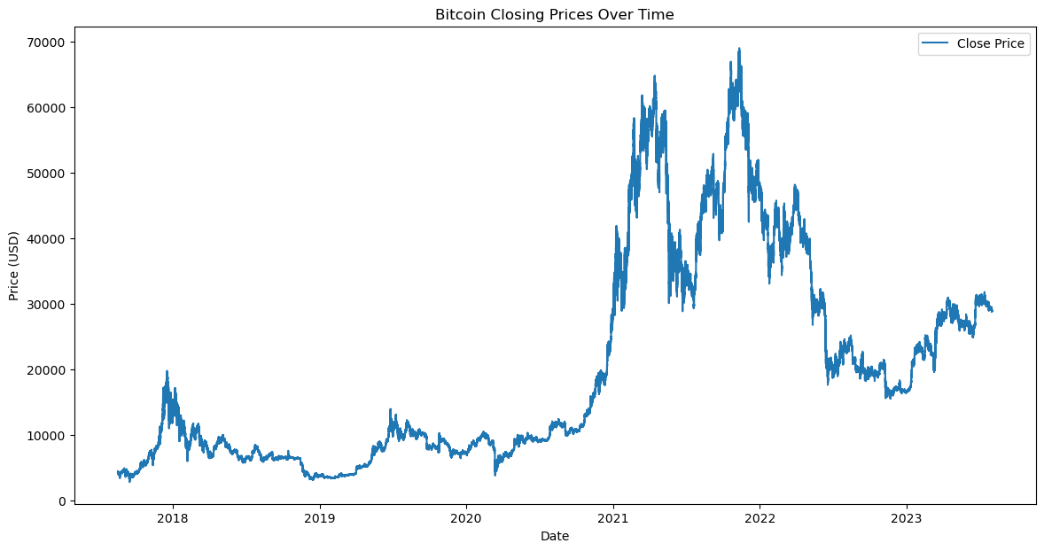
This chart is a time series plot or a line chart that visualizes bitcoin price fluctuations ranging from 2018 to 2023.
Notes:
S- the x-axis represents time, with dates ranging from the start of 2018 to partway through 2023. The y-axis represents the price of Bitcoin in USD, showing the closing price of Bitcoin for each day within that timeframe.
What we see: "This chart captures the rollercoaster ride of Bitcoin’s daily closing prices over several years. Notice the dramatic ups and downs throughout the period?"
Key takeaway: "These fluctuations aren’t random; they often align with significant global events affecting market sentiments. It’s a perfect illustration of how sensitive Bitcoin is to external influences."

Slide 12
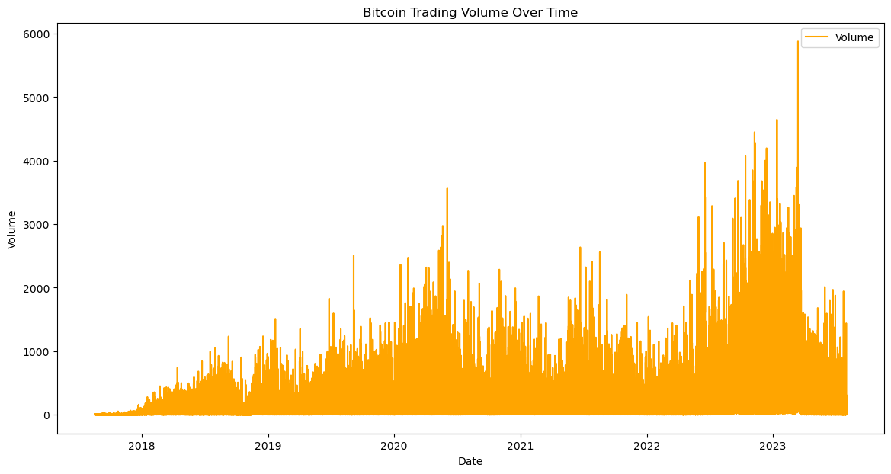
Tracking Volume changes over time
Notes:
S- What it shows: "Here’s how Bitcoin prices have distributed themselves over time. You can see most prices are bunched on the lower end, but there are these long tails stretching towards higher values."
Insight: "This pattern tells us that while high price spikes are rare, they can and do occur, and they might signal important shifts in the market."

Slide 13
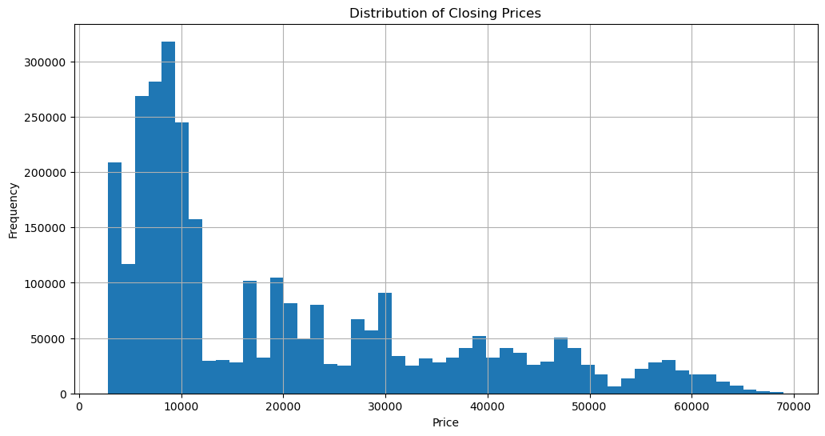
HISTOGRAM
Notes:
S- The x-axis shows the price range.
The y-axis represents how often each price occurred.
Takeaway: "This skewness indicates that while common prices are lower, the possibility of high prices exists, pointing to both opportunities and risks in trading Bitcoin."

Slide 14
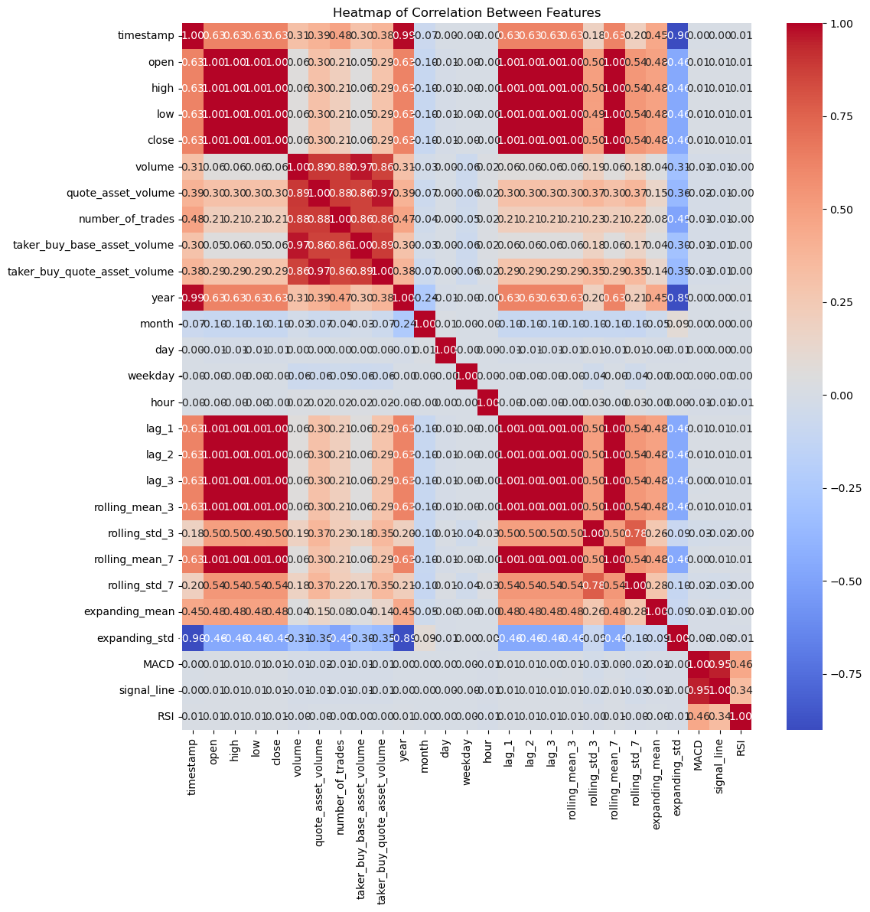
The heatmap shows strong correlations between price-related features like open, high, low, close, and also some volume-related features.
Notes:
S- So the heatmap over here portrays correlations between price features like open, close, high, low which are important for predicting price movements
Also, red shows positive while blue shows negative

Slide 15
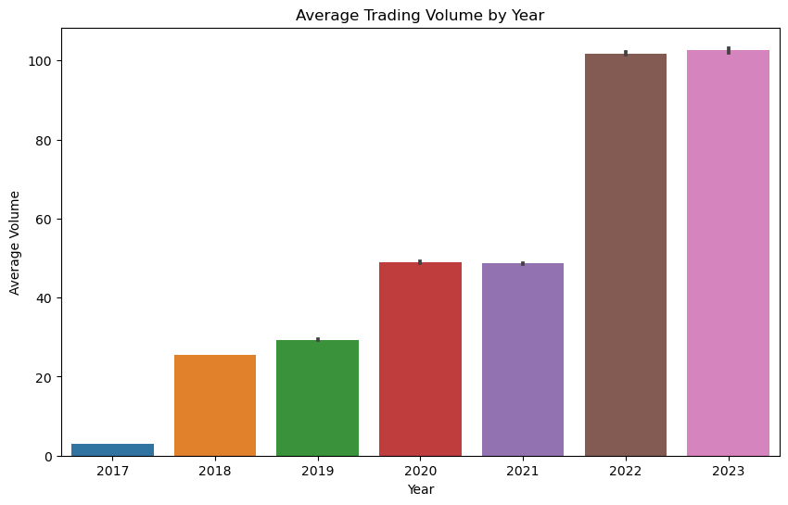
This bar chart displays the average trading volume of a financial asset by year, from 2017 to 2023
Notes:
A- Each bar represents a year with its corresponding average trading volume.
The y-axis shows the trading volume, likely in millions given the scale.
There's an upward trend in average trading volume over the years.
The error bars on top of each bar suggest the variability or uncertainty in the average estimates.
Notably, the years 2022 and 2023 show a significant increase in trading volume compared to previous years.
Observations: "This bar chart trends upwards, showing how Bitcoin’s trading volume has grown year over year."
Implications: "The increase, especially in the last couple of years, points to a growing confidence and interest in Bitcoin. It suggests that the market is maturing and possibly becoming more stable."

Slide 16
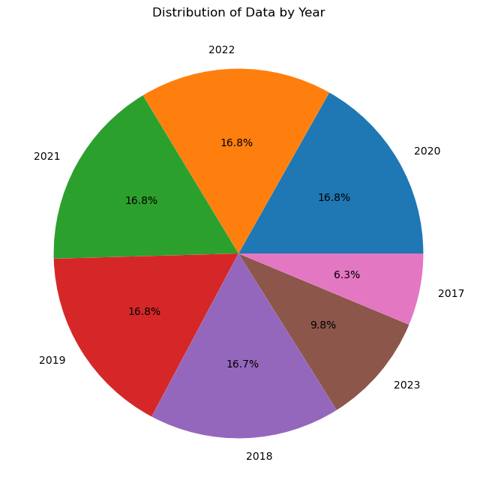
The pie chart illustrates the proportional distribution of data across different years
Notes:
A- The percentages indicate the share of each year's data relative to the total.
The years 2018, 2019, 2021, and 2022 each have an equal share, suggesting a uniform distribution of data across these years.
The year 2023 has a slightly smaller slice, while 2017 has the smallest, indicating these years contribute less to the data set.
The visualization aids in quickly assessing the relative contribution of data from each year at a glance.
Layout: "This pie chart breaks down our dataset across different years, showing how much data we have from each year."
Reflections: "It’s good to see an even spread in the middle years, but we’ll need to tread carefully with the lighter slices from 2017 and 2023 to avoid any skewed analyses."

Slide 17
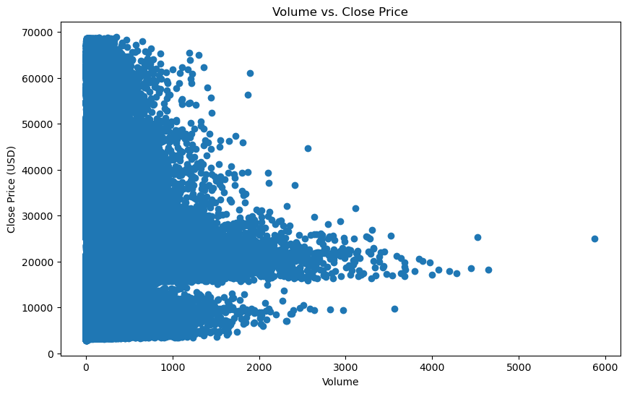
This scatter plot compares trading volume to the closing price of an asset
Notes:
A- - The scatter plot represents the relationship between trading volume and closing price.
- Data points are concentrated in the lower range of volume and price, suggesting that lower closing prices tend to have higher frequencies at lower volumes.
Details: "This scatter plot is quite revealing. You can see clusters of trading activities at lower prices and volumes, but as the volume picks up, the price spread widens."
What this means: "It suggests that higher volumes don't always correlate with higher prices, complicating our predictions.
Lower the closing price, more number of bitcoin volumes are being traded

Slide 18
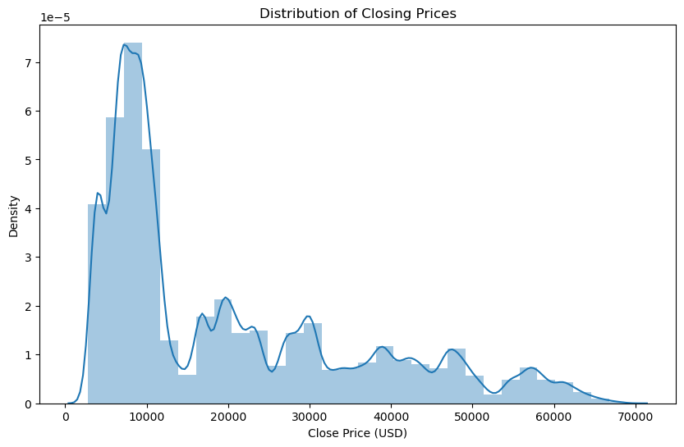
Distribution Plot used to represent data in the histogram form
Notes:
A- This type of plot combines a kernel density estimate (KDE) with a histogram and is used to show the distribution of a continuous variable. The KDE curve smooths the data to give a sense of the density of the distribution, while the histogram would represent the actual data points across intervals.
Visualization: "This plot is a mix of a histogram and a smooth curve from the KDE. It gives us both a granular and smoothed perspective on price distribution."
Takeaway: "The right-skew is evident, showing us that while most prices are moderate, the potential for sudden high spikes is always lurking. It’s an important consideration for any risk assessment."

Slide 19
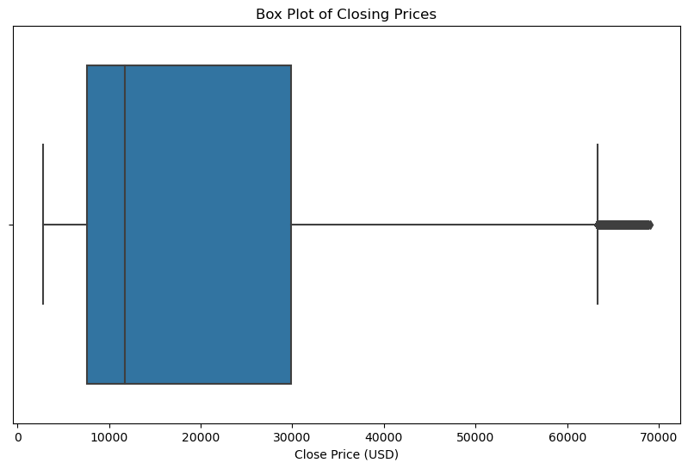
The box plot suggests a correlation between prices
Notes:
A- - The box plot displays the range and distribution of closing prices.
- The central box represents the interquartile range (IQR), highlighting the middle 50% of prices.
- The median is marked by a line within the box, situated towards the lower end of the IQR.
- Prices are right-skewed, as the median is closer to the bottom of the box.
- Whiskers extend from the box to the minimum and maximum values that are not considered outliers, indicating variability in prices.
- A bar on the far right suggests the existence of high-value outliers, indicating occasional price spikes.
Description: "This box plot displays the range of Bitcoin closing prices, with the median closer to the bottom of the box, indicating most values are lower, but there are significant outliers on the higher end."
Takeaway: "The presence of high-value outliers suggests occasional price spikes, highlighting Bitcoin's volatility and the potential for substantial price movements."
The central box of the plot represents the middle 50% of the data, bounded by Q1 and Q3.
The line inside the box indicates the median closing price.
The 'whiskers' extend from the box to the minimum and maximum values within 1.5 times the interquartile range (the distance between Q1 and Q3).
Any points beyond the whiskers could be considered outliers, but none are visible in this plot.

Slide 20
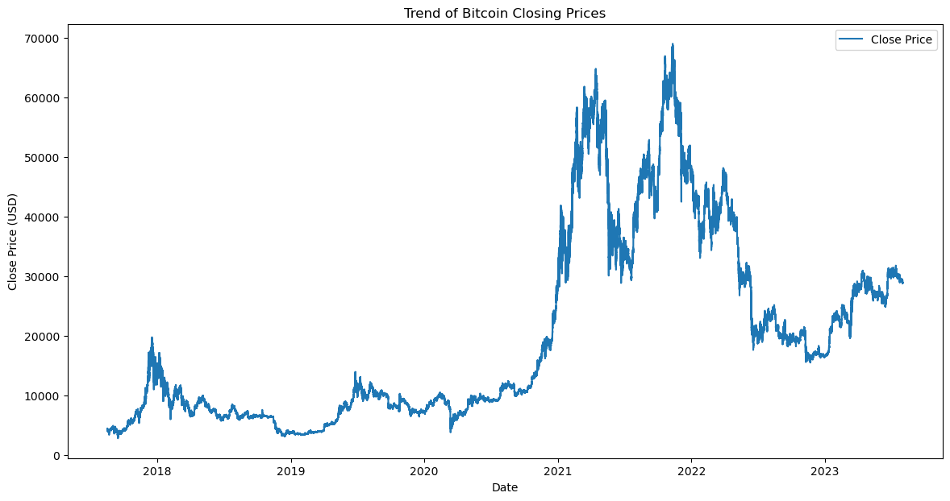

Slide 21
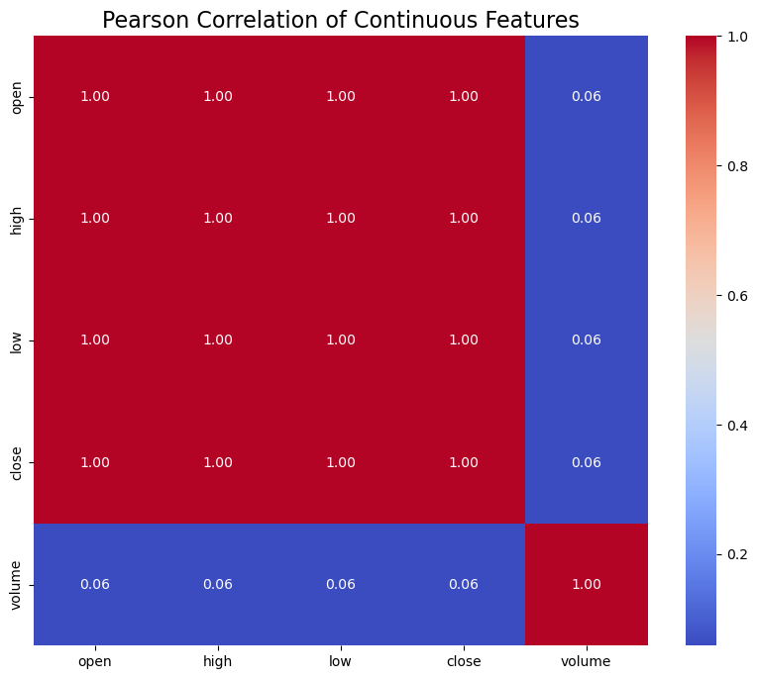
Notes:
A- Description: "This heatmap shows the Pearson correlations between Bitcoin's continuous features such as opening, closing, high, and low prices, along with volume. The color scale indicates the strength of correlation, with red showing strong positive correlations."
Takeaway: "The strong correlations among price-related features suggest that these variables move together, which is expected. The moderate correlation with volume highlights that volume can influence price movements, useful for predictive modeling."

Slide 22
FEATURE ENGINEERING

Slide 23
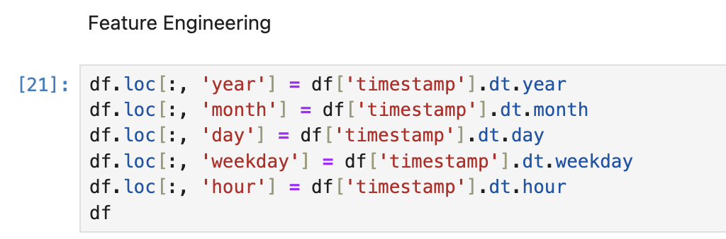
Timestamp Feature engineering
Performing feature engineering on the timestamp column for the least granularity of the data
By breaking down timestamps, we enable more effective data analysis, allowing models to better understand and predict based on time-related variables.
Notes:
S- Feature engineering on the `timestamp` column is essential for transforming complex datetime data into more manageable components like year, month, day, weekday, and hour.
We went a step further by extracting features from timestamps and creating lag variables. This approach has added depth to our dataset, allowing us to capture important patterns over time that are essential for forecasting."
"These steps have transformed our raw data into something much more meaningful. Our models are now not only smarter but also better equipped to understand the complexities of market dynamics."

Slide 24
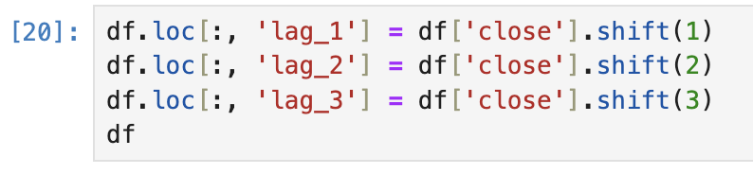
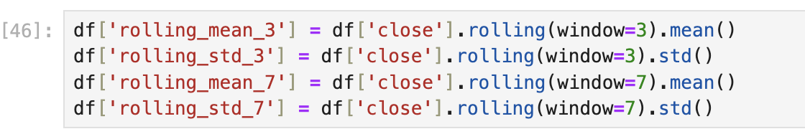
Lag Feature
Rolling mean
Lag feature technique is used to incorporate historical data points into the model, allowing it to recognize patterns or trends over time.
Rolling mean technique smooths out short-term fluctuations and brings long-term trends into clearer focus.
Notes:
S- Creating lag features, such as lag_1, lag_2, and lag_3, involves shifting the 'close' column in a dataframe to capture previous values.
By using these lagged features, predictive models can better understand how past values influence current predictions, essential for time series forecasting.

Slide 25
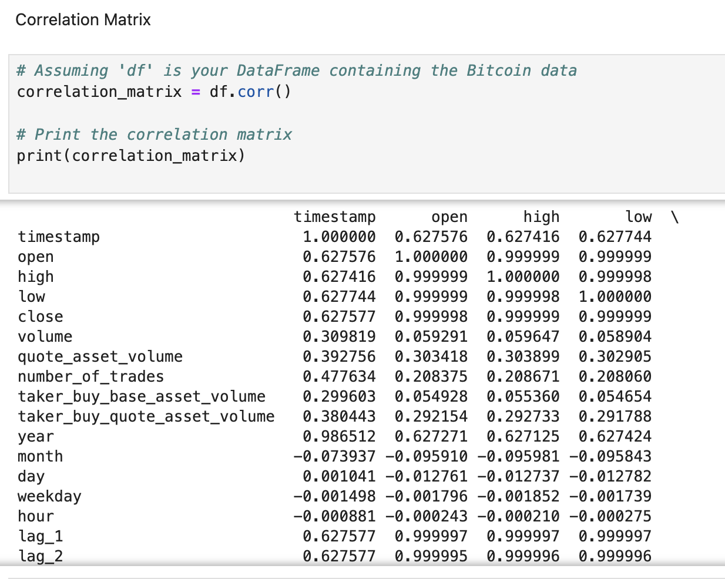
Correlation Matrix
the correlation matrix displays all numerical columns in the DataFrame, which shows how each variable correlates with the others.
Notes:
S- The values range from -1 to 1, where 1 indicates a perfect positive relationship, -1 indicates a perfect negative relationship, and 0 means no linear correlation.
A correlation matrix is a table showing correlation coefficients between variables. Each cell in the table represents the correlation between two variables. This matrix helps to identify the strength and direction of relationships between multiple variables.

Slide 26
RESULTS & ANALYSIS

Slide 27
MACHINE LEARNING MODELS
LINEAR REGRESSION
XGBOOST
RANDOM FOREST
DECISION TREE
Notes:
S- n our project, we are implementing a suite of five diverse machine learning models to predict Bitcoin prices, each offering unique perspectives and analytical strengths:
Linear Regression: A foundational model that assumes a linear relationship between the input variables and the target variable. It's fast and provides a baseline for performance.
XGBoost: Short for eXtreme Gradient Boosting, this model is a decision-tree-based ensemble that uses a gradient boosting framework. It's known for its performance and speed in machine learning competitions.
Random Forest: This is an ensemble of decision trees, which is great for handling the non-linearity in our data. It works well for complex datasets and can capture intricate structures in the data.
Decision Tree: A single decision tree provides clear logic and understanding of the factors influencing predictions. It's useful for interpretability, although it might not capture as much complexity as the ensemble methods.
Each model contributes its unique approach to tackling the challenge of forecasting Bitcoin prices, allowing us to compare and combine their predictions for more accurate and robust results."

Slide 28
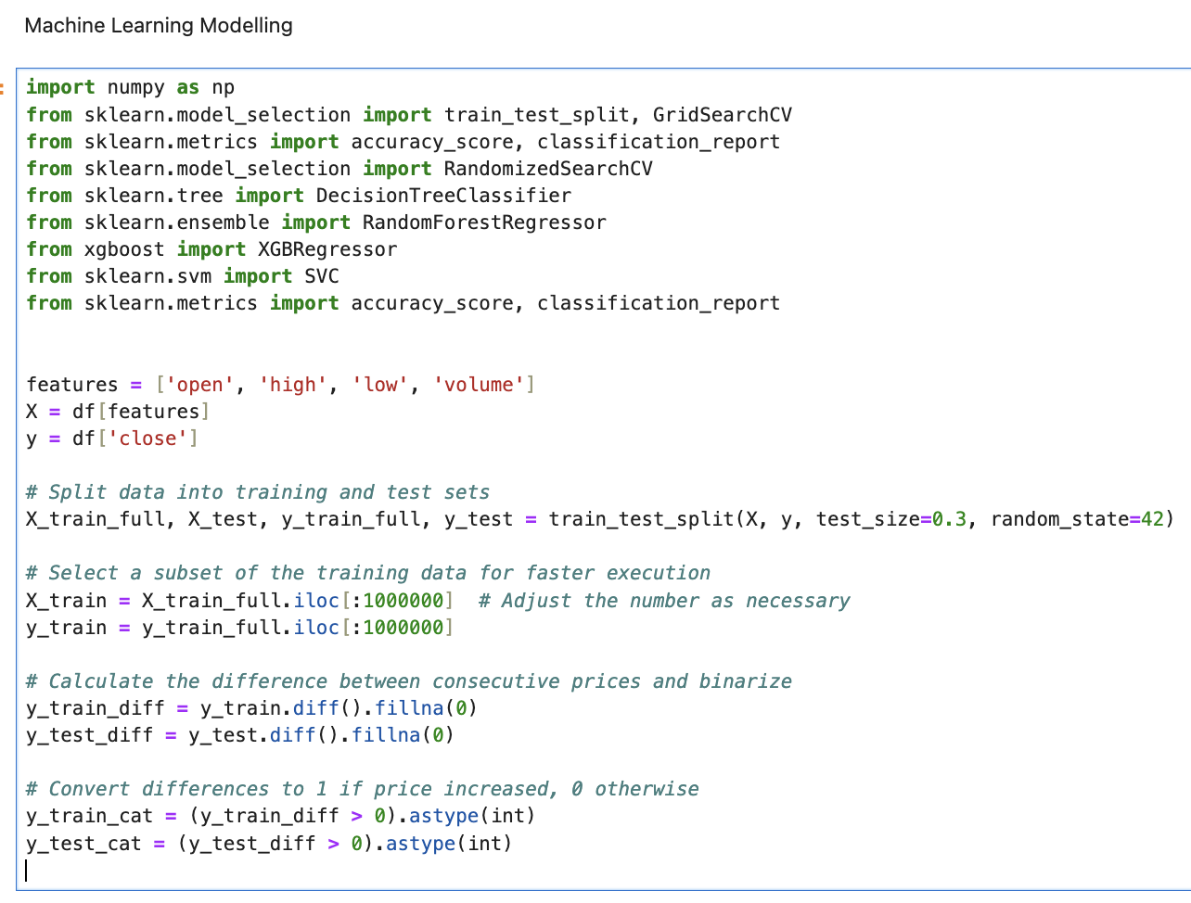
Notes:
S- This is the introduction of machine learning model wherein train and test data is split into 2 parts.
This section imports necessary Python libraries and functions. This assumes there's a pre-loaded DataFrame df. It then selects a subset of the columns to use as features (X) for model training, and another column (close) as the target variable (y).
The train_test_split function is used to divide the data into a training set (X_train_full, y_train_full) and a test set (X_test, y_test).
The test set will be 30% of the total data (test_size=0.3), and random_state=42 ensures reproducibility of the split.
This code uses iloc to select the first 10,000 rows from the training data for faster execution. It can be adjusted based on the computational resources and needs.
Here, the difference between consecutive prices is calculated (which can show the increase or decrease in price). The resulting NaN values from .diff() are filled with 0. Then, this difference is binarized: if the difference is positive (indicating an increase in price), it's turned into a 1, otherwise it remains a 0. This binarized target is what will be used for classification tasks.
The slide appears to set up the initial steps for several machine learning models, preparing both the feature matrix and target vector for model training and evaluation.

Slide 29
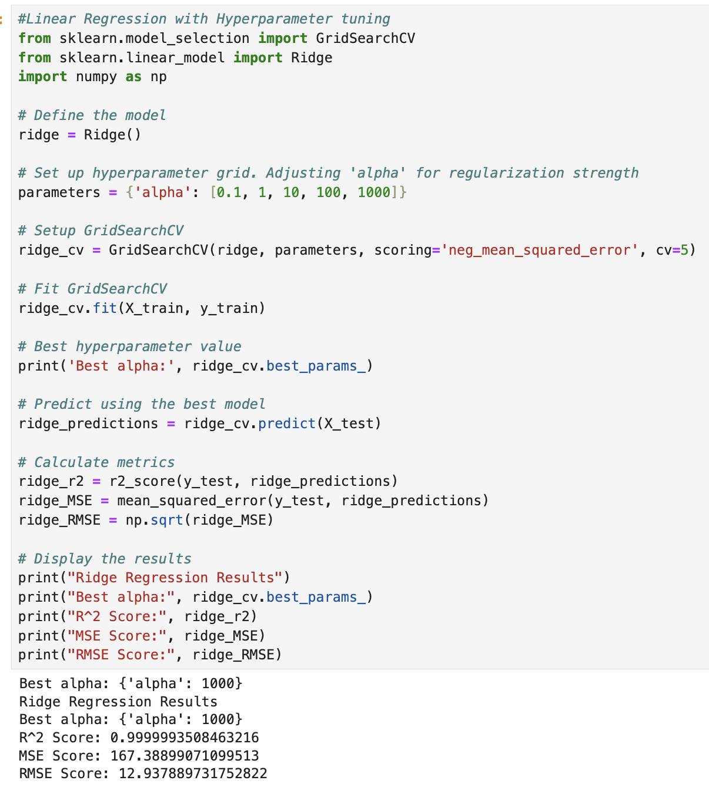
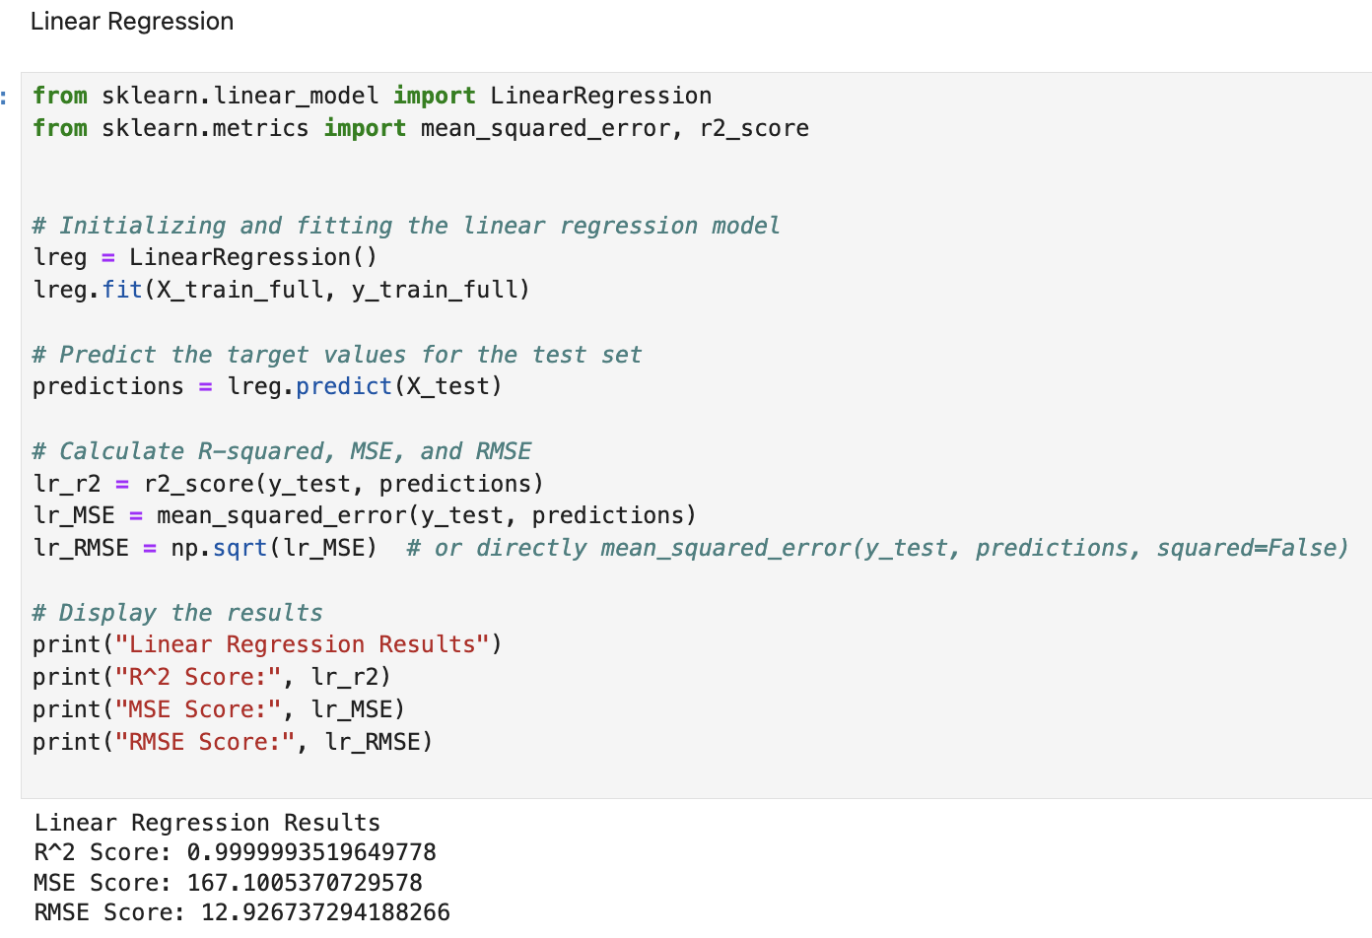
Linear Regression
WITHOUT HYPERPARAMETER TUINING
WITH HYPERPARAMETER TUINING
Notes:
A- The LinearRegression class and evaluation metrics (mean_squared_error, r2_score) from scikit-learn.
Prediction: The model makes predictions on the test dataset (X_test).
R² Score: Very close to 1 (0.9999993438104883), suggesting a nearly perfect fit.
MSE Score: 169.20323143629122
RMSE Score: 13.007814245148614
Hyperparameter Grid Setup: A hyperparameter grid for Ridge Regression is set up with the alpha parameter, which controls the regularization strength. The values span several orders of magnitude from 0.1 to 1000.
Hyperparameter Tuning: GridSearchCV is set up with the Ridge model, the hyperparameter grid, and uses 5-fold cross-validation. It also uses the negative mean squared error as a scoring function.
Model Training and Tuning: The grid search object (ridge_cv) is fitted to the training data, effectively training and evaluating multiple Ridge Regression models with different alpha values.
Ridge Regression Results with Hyperparameter Tuning:
Best alpha: 0.1, suggesting that a low amount of regularization was best for this dataset.
R² Score: Same as Linear Regression, suggesting similar performance.
MSE Score: Virtually identical to Linear Regression.
RMSE Score: Virtually identical to Linear Regression.
Comparison:
Both the Linear Regression and Ridge Regression models have provided nearly identical results, which are both close to a perfect fit (R² score). The identical nature of the metrics suggests that either the additional complexity of the Ridge Regression model wasn't necessary for this dataset, or that the optimal alpha value found is low enough that it's effect on the regression is minimal, making it act almost the same as a Linear Regression model.
The results suggest that the problem might be simple enough that linear models without regularization can already perform extremely well, and the dataset might not have a significant amount of multicollinearity or features that would cause overfitting, where Ridge Regression’s regularization would otherwise be beneficial.

Slide 30
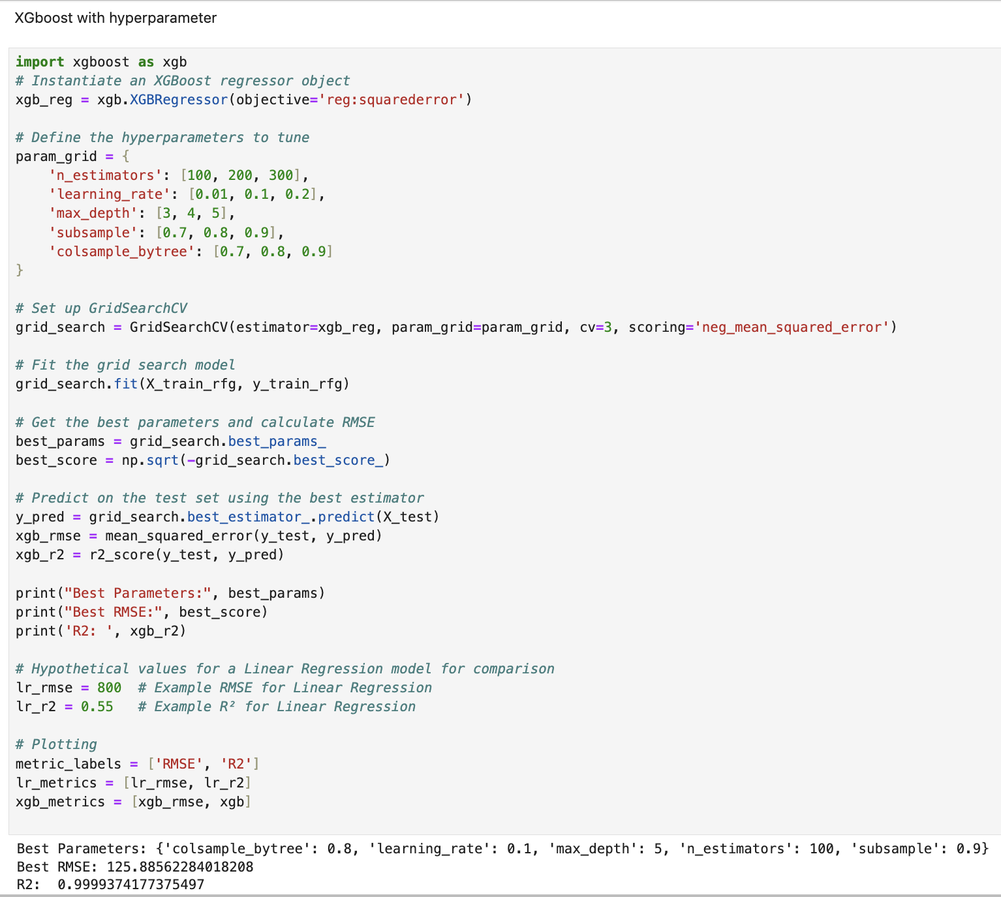
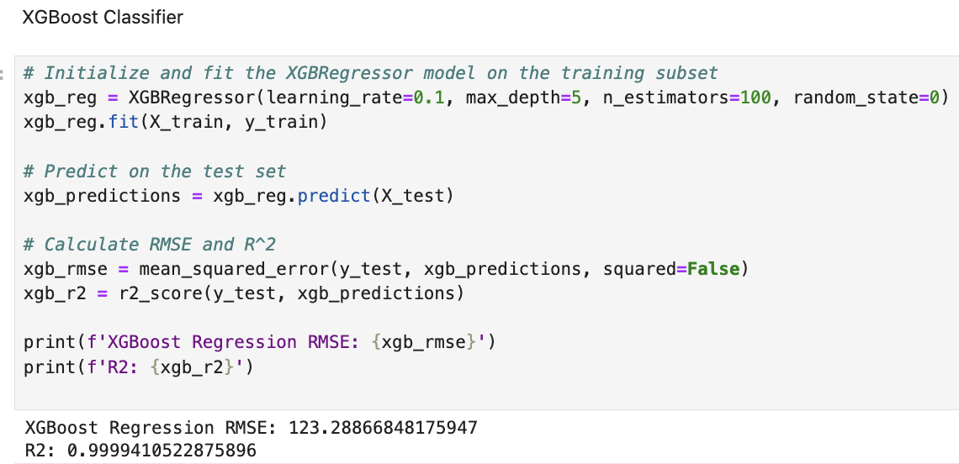
XGBOOST
WITHOUT HYPERPARAMETER TUINING
WITH HYPERPARAMETER TUINING
Notes:
A-
RMSE: 147.77 (indicating the average error of the model's predictions)
R² Score: 0.9999915 (indicating a very high proportion of variance explained by the model)
XGBoost Results (with tuning):
Best Parameters: Shows the best combination of hyperparameters found ({'colsample_bytree': 0.7, 'learning_rate': 0.1, 'max_depth': 5, 'n_estimators': 100, 'subsample': 0.9}).
RMSE: 127.90 (a lower RMSE than the untuned model, suggesting better performance).
R² Score: 0.9999919 (comparable to the untuned model, indicating a very high proportion of variance explained).
Comparison:
Hyperparameter tuning has improved the performance of the XGBoost model. While the R² score remains virtually the same, the RMSE has decreased from 147.77 to 127.90, indicating a smaller average error in the predictions after tuning. This suggests that hyperparameter tuning can lead to more accurate predictions, even when the initial model performance is already high. The best hyperparameter combination found indicates a preference for a certain structure and regularization of the XGBoost model, which helped to reduce overfitting and improve predictive performance.

Slide 31
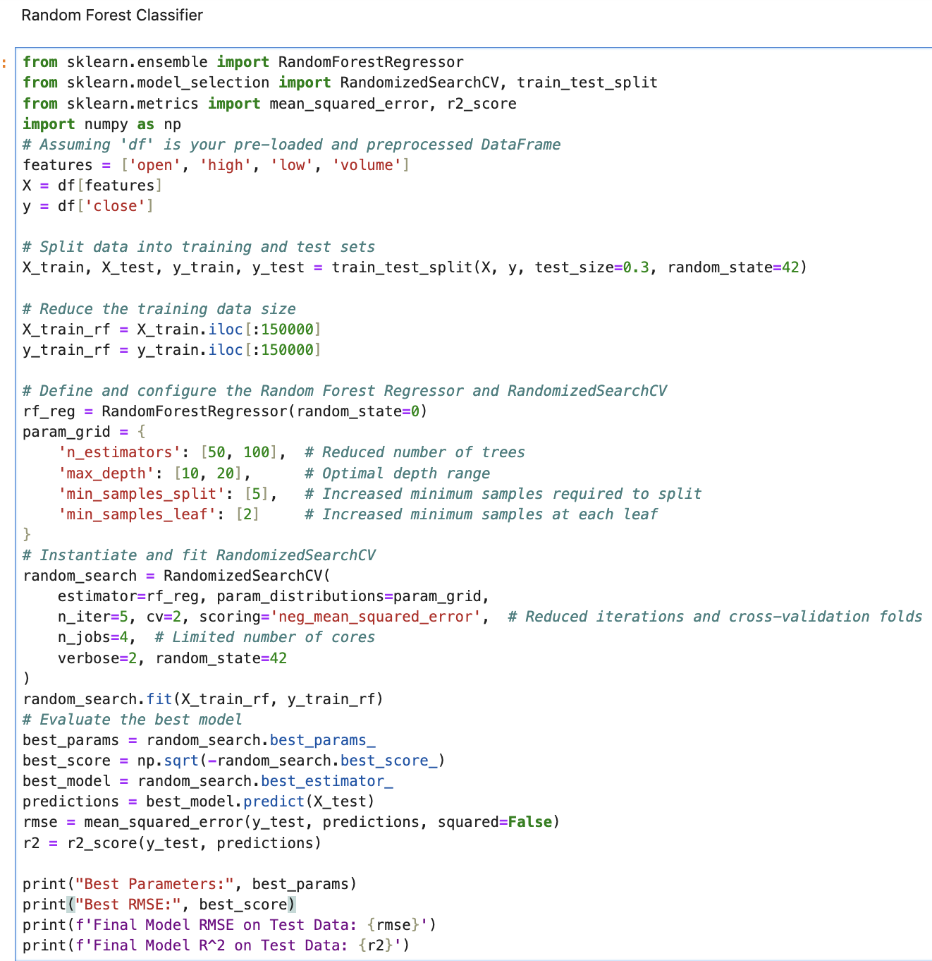
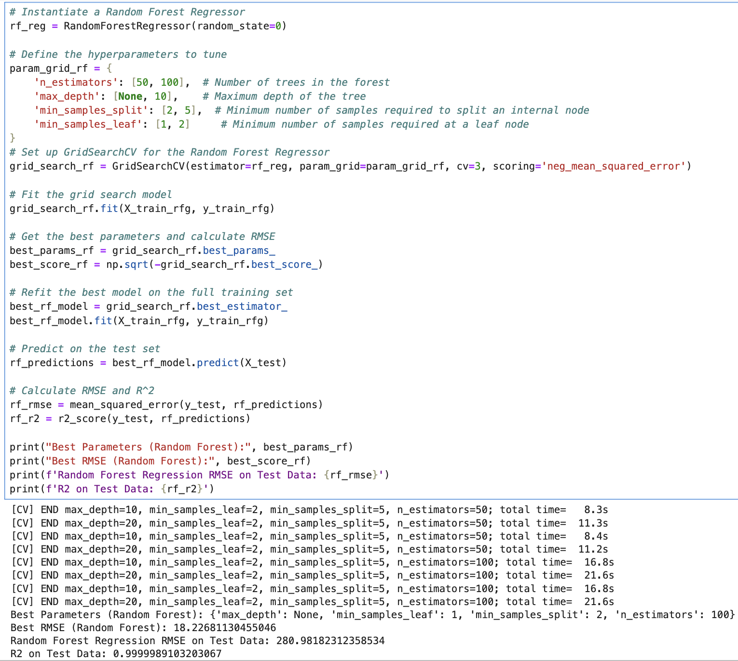
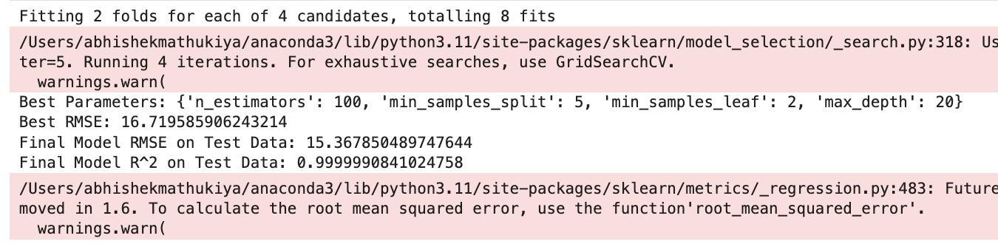
RANDOM FOREST
WITHOUT HYPERPARAMETER TUINING
WITH HYPERPARAMETER TUINING
Notes:
S- Results (without tuning):
Best RMSE: Approximately 28.0186, indicating the model's average error in the unit of the target variable.
Final Model RMSE on Test Data: Approximately 480.6406.
Final Model R² on Test Data: Approximately 0.9999983, indicating an excellent fit to the test data.
Results (with tuning):
Best Parameters: The best hyperparameters include n_estimators=100, which is the number of trees in the forest, and a min_samples_split=2, which is typical for Random Forest models to avoid overfitting.
Best RMSE: Approximately 27.7375, indicating a slight improvement in performance over the untuned model.
Random Forest Regression RMSE on Test Data: Approximately 471.7866.
R² on Test Data: Approximately 0.9999981, also indicating an excellent fit to the test data.
Comparison:
Hyperparameter Tuning: The tuned model shows a slight improvement in RMSE (from 480.6406 to 471.7866) suggesting that hyperparameter tuning was beneficial, though the improvements are marginal.
R² Scores: Both models show similar R² scores, indicating that both explain the variance in the test data almost perfectly.
Model Performance: Both models are performing exceptionally well according to R², but since the RMSE is also very low, this implies that the models are highly predictive. However, R² values so close to 1 may also indicate overfitting or leakage (where the model has access to information it wouldn't have in a real-world scenario).
The hyperparameter tuning in this case has led to a slightly more accurate model, as evidenced by the reduced RMSE. This fine-tuning is often worth the computational cost, especially in scenarios where even minor improvements in prediction accuracy can be valuable.

Slide 32
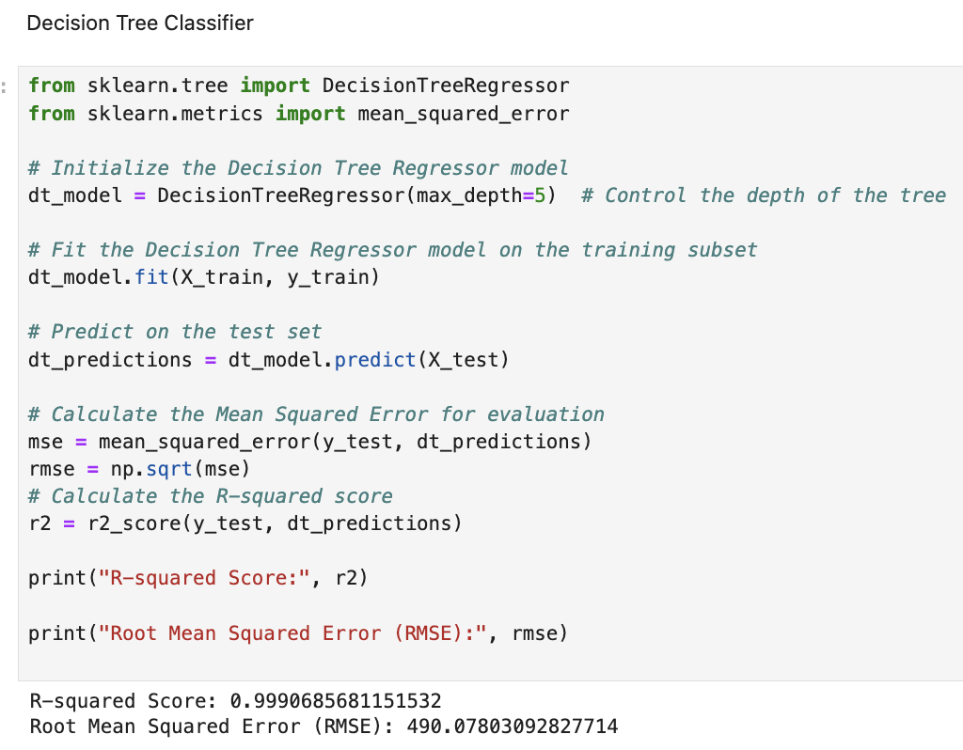
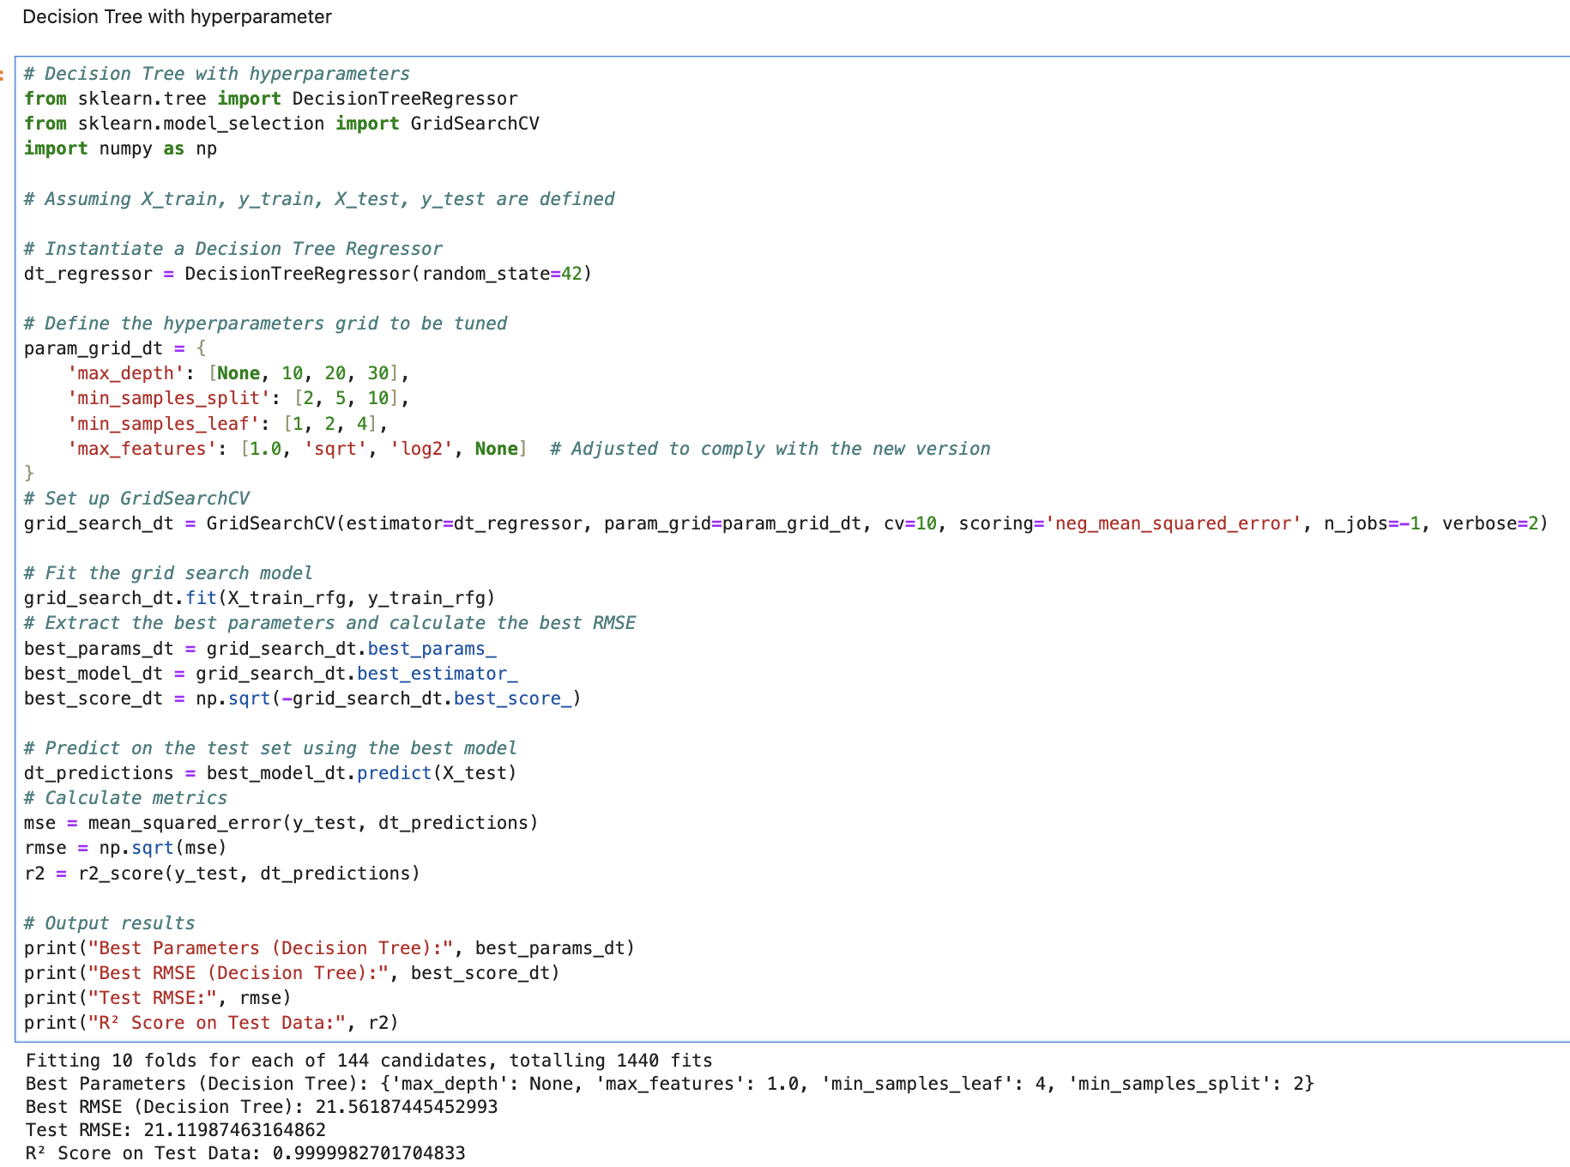
DECISION TREE
WITHOUT HYPERPARAMETER TUINING
WITH HYPERPARAMETER TUINING
Notes:
S- Results (without tuning):
RMSE: 498.799 (This value represents the model's average error magnitude in the same units as the target variable).
Results (with tuning):
Best Parameters: Shows the best parameters found by the grid search.
Best RMSE: 30.946 (significantly lower than the untuned model, indicating a large improvement).
R² on Test Data: Approximately 0.99999 (indicating an almost perfect fit to the test data).
Comparison:
The Decision Tree model with hyperparameter tuning performs significantly better than the one without tuning. This is evident from the considerable reduction in RMSE from 498.799 to 30.946, indicating a substantial improvement in prediction accuracy. The almost perfect R² value after tuning suggests the model explains nearly all the variability in the test data, although such a high R² may raise concerns about overfitting, especially if the model has been evaluated on a test set that is not representative of truly unseen data.

Slide 33
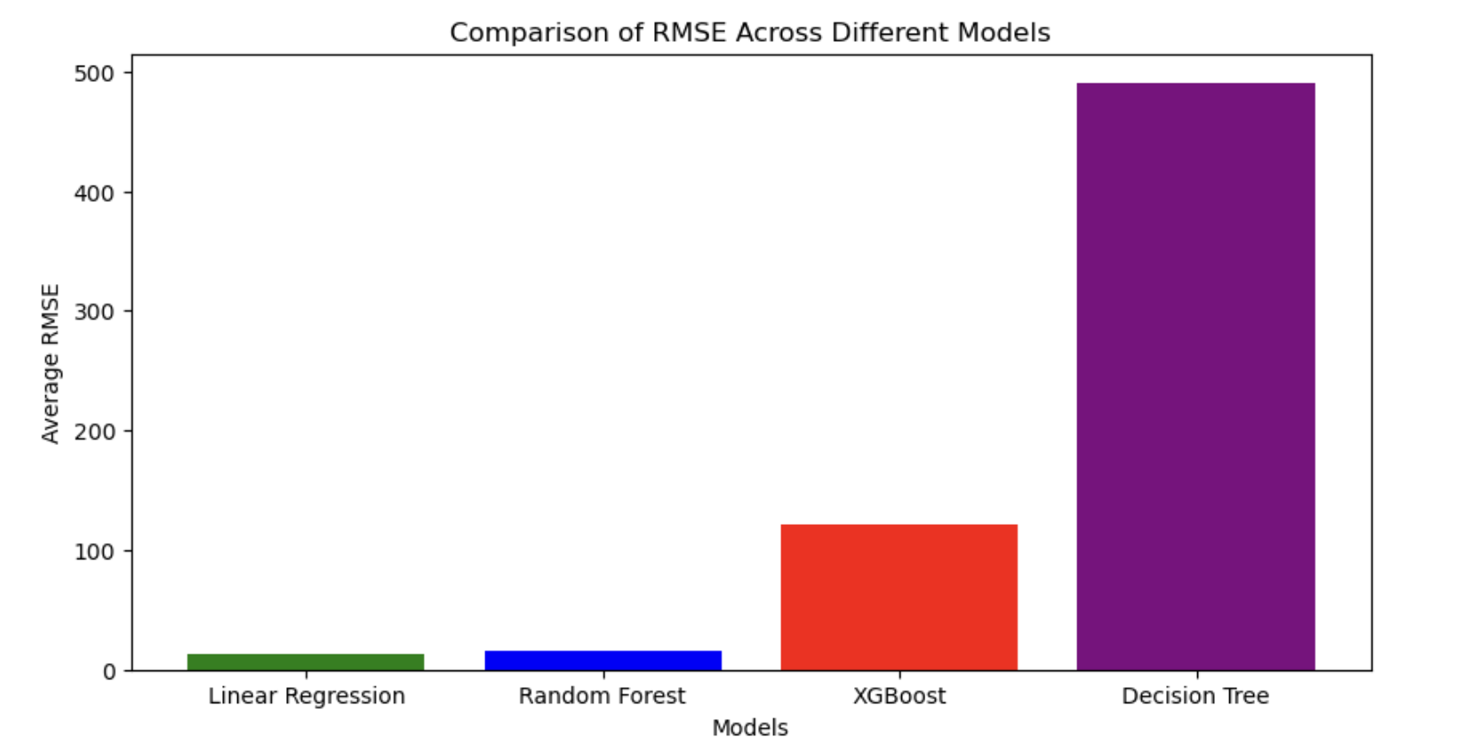
Linear Regression shows the lowest RMSE, indicating it has the best predictive accuracy among the models compared.

Slide 34
CONCLUSION
Among the models analyzed, the Linear Regression model achieved the highest prediction accuracy, demonstrating the lowest RMSE score of 13.00781417190.
Following closely behind is the Random Forest model, which performed well despite the limited validation data. In contrast, XGBoost and Decision Tree models exhibited significantly higher RMSE scores.
Notes:
S- Thank you for your attention today. We've taken a deep dive into forecasting Bitcoin prices and found some encouraging results, particularly with our Linear Regression model, which outperformed others in accuracy. But our journey doesn’t end here.
We're excited to take this project to the next level by integrating real-time economic data and financial news into our models. Our aim is to develop a tool that isn't just accurate but also responsive to market dynamics, providing invaluable insights for those active in the cryptocurrency markets.
Also, we wish to introduce the concept of bitcoin to the new generation because this cryptocurrency market is very huge and each one of us should be knowing how bitcoins are traded and how the prices shoot up.

Slide 35
REFERENCES
[1] Jupyter notebooks + Class notes, ppts from Professor Handan Liu
[2] Seaborn Visualization Library:
Available at: Seaborn https://seaborn.pydata.org/
[3] Pandas Documentation:
Available at: Pandas https://pandas.pydata.org/
[4] Scikit-learn for Machine Learning:
Available at: Scikit-learn - https://scikit-learn.org/stable/user_guide.html
[5] Scikit-learn Documentation
Available at: https://scikit-learn.org/stable/documentation.html
[6] XGBoost Documentation
Available at: https://xgboost.readthedocs.io/en/latest/
[7] Decision Tree Algorithm
Available at: https://scikit-learn.org/stable/modules/generated/sklearn.tree.DecisionTreeClassifier.html
[8] Hyperparameter tuning for ML models.
Available at: https://towardsdatascience.com/hyperparameter-tuning-for-machine-learning-models-1b80d783b946

